Slide 1
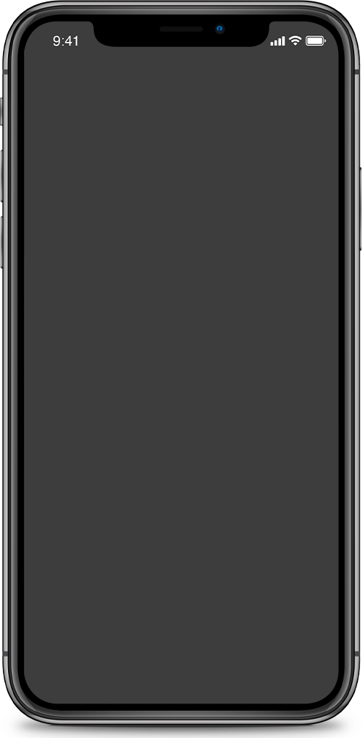
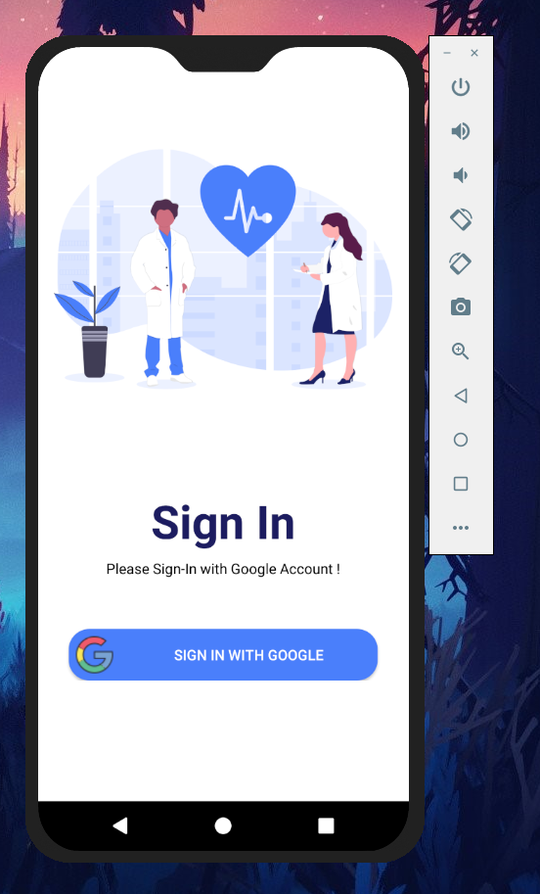
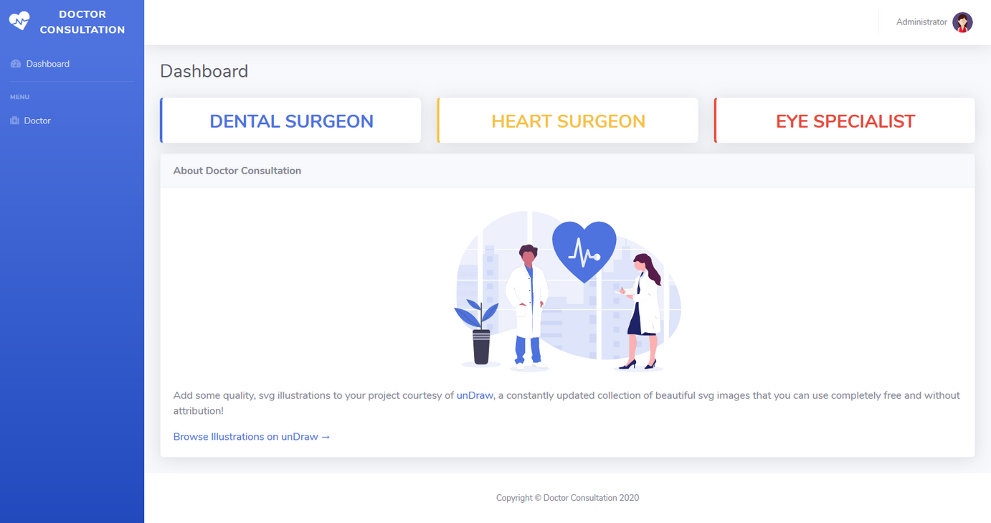
Doctor Consultation

Slide 2

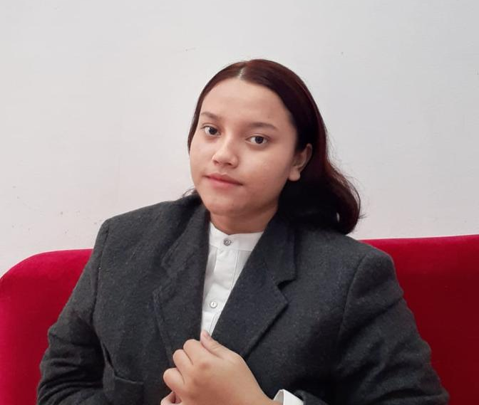
MEET OUR TEAM
Muhammad Dani Setiawan
Annisa Tresnandarie

Slide 3


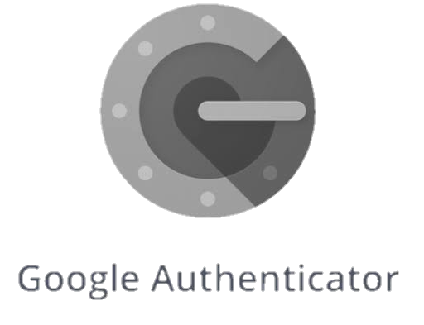

WHAT WE USED

Slide 4
OVERVIEW
ABOUT OUR PROJECT
DOCTOR CONSULTATION

Slide 5
FUNDAMENTAL OF SOFTWARE ENGGINERING
SOFTWARE ENGGINERING

Slide 6
SOFTWARE DEVELOPMENT LIFE CYCLE
Stages of SDLC
SDLC Methodology
Function of SDLC

Slide 7
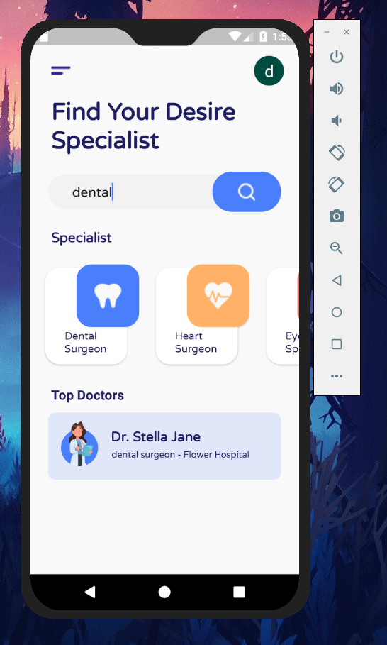
APP
DEMO

Slide 8
WEB
DEMO

Slide 9

QUESTION?
SUGGESTION?
LET US KNOW

